Slide 1
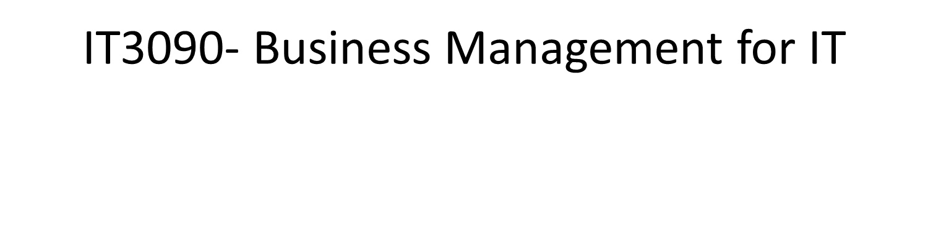
Lecture 02 – Basics of Management (Part 2)
IT3090 - Business Management for IT- Lecture 02 - Ms. Nilmini Rathnayake

Slide 2
Learning Outcomes
At the end of the session students will be able to;
Leading
Leadership
Motivation
Team Management
Controlling
IT3090 - Business Management for IT- Lecture 02 - Ms. Nilmini Rathnayake

Slide 3

Leading
Management Functions
What is the basic economic problem ?
IT3090 - Business Management for IT- Lecture 02 - Ms. Nilmini Rathnayake

Slide 4
Leading (Cont’d…)
Leading is simply motivating and managing people of the organization to achieve allocated tasks and responsibilities finally leading to achieve goals.
e.g.
How the manager can make employees work hard, with good team spirit?
How the manager can encourage a sales person who failed to achieve given targets?
IT3090 - Business Management for IT- Lecture 02 - Ms. Nilmini Rathnayake

Slide 5


Leadership

Slide 6
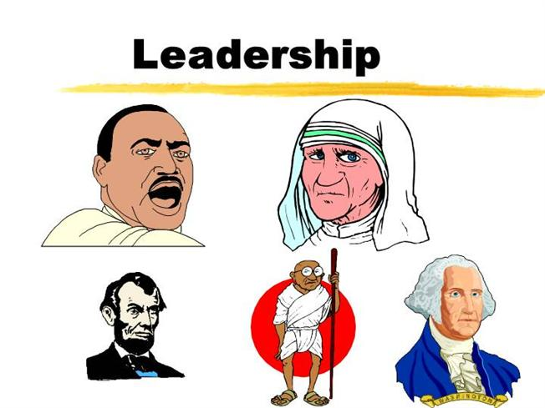
Definition Leading/ Leadership
Leader is a person who can influence others and who has managerial authority
(Stephen P. Robbins).
Leadership is the process of influencing a group towards the achievement of goals
(Stephen P. Robbins,).
IT3090 - Business Management for IT- Lecture 02 - Ms. Nilmini Rathnayake

Slide 7

Leadership Theories
Trait Theory
Behavioral Theory
Charismatic leadership
IT3090 - Business Management for IT- Lecture 02 - Ms. Nilmini Rathnayake

Slide 8
Trait Theory
“Leaders are born rather than made.”
People are born with inherited traits.
Some traits are particularly suited to leadership
People who make good leaders have the right combination of traits.
IT3090 - Business Management for IT- Lecture 02 - Ms. Nilmini Rathnayake

Slide 9
Behavioral Theories
Leaders can be made, rather than born
Behavioral theory researchers tried to determine what effective leaders do –
how they delegate tasks
how they communicate with and try to motivate their followers or employees
how they carryout their tasks
IT3090 - Business Management for IT- Lecture 02 - Ms. Nilmini Rathnayake

Slide 10
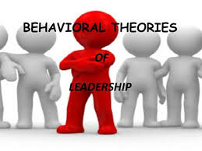
Behavioral Theories (Cont’d…)
Kurt Lewin - Concentrated on three leadership styles.
Autocratic
Participative
Laissez – faire
IT3090 - Business Management for IT- Lecture 02 - Ms. Nilmini Rathnayake

Slide 11
Behavioral Theories – Kurt Lewin
The autocratic Leader
tends to make decisions without involving subordinates.
spells out work methods
sometimes give negative feedback
The participative Leader
Includes the group in decision making
Consults the subordinates on proposed actions and encourage participation from them.
let the group determine work methods
use feedback to help subordinates
IT3090 - Business Management for IT- Lecture 02 - Ms. Nilmini Rathnayake

Slide 12
Behavioral Theories – Kurt Lewin (Cont’d…)
Laissez faire Leaders
Use their power very rarely
Give the group complete freedom
Allows subordinates to set their goals and the means for achieving them
Avoid giving feedback
IT3090 - Business Management for IT- Lecture 02 - Ms. Nilmini Rathnayake

Slide 13

Charismatic Leadership
Form of international attraction that inspires support and acceptance
An enthusiastic, self-confident leader whose personality and actions influence people to behave in certain ways.
IT3090 - Business Management for IT- Lecture 02 - Ms. Nilmini Rathnayake

Slide 14
Charismatic Leadership (Cont’d…)
Characteristics:
Have a compelling vision
Ability to articulate that vision
Demonstrate consistency and focus
Know their strengths and capitalize on them
Strong self confidence and make others also confident
IT3090 - Business Management for IT- Lecture 02 - Ms. Nilmini Rathnayake

Slide 15
Motivation

Slide 16

Motivation and Human Needs
Needs and wants are always related with motivation
A rational person always seek to satisfy one or more of their needs
So they try to find a way to satisfy their need.
IT3090 - Business Management for IT- Lecture 02 - Ms. Nilmini Rathnayake

Slide 17
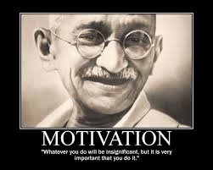
Motivation Defined
The driving force within individuals by which they attempt to achieve a goal in order to fulfill some need or expectation.
IT3090 - Business Management for IT- Lecture 02 - Ms. Nilmini Rathnayake

Slide 18
Maslow’s Hierarchy of Needs
Maslow presented his theory based on certain assumptions:
Individuals are perpetually(forever, continuously) wanting animals.
Only unsatisfied needs are capable of motivating behavior.
Five levels of needs could be arranged in a hierarchy.
Once the lower level needs are been satisfied , individuals will be motivated to achieve higher level of needs.
IT3090 - Business Management for IT- Lecture 02 - Ms. Nilmini Rathnayake

Slide 19
Maslow’s Hierarchy of Needs (Abraham Maslow)
NEEDS
General Examples
Organizational Examples
Self-
actualization
Challenging
job
Achievement
Status
Esteem
Job
title
Friendship
Belongingness
Friends
at work
Stability
Security
Pension
plan
Food
Physiology
Base
salary

Slide 20
Team Management

Slide 21

Stages of Team Development
Forming Stage
Storming Stage
Norming Stage
Performing Stage
IT3090 - Business Management for IT- Lecture 02 - Ms. Nilmini Rathnayake

Slide 22

Stages of Team Development (Cont’d…)
Forming Stage : Building awareness
People act in a formal manner (anxious)
Feelings and weaknesses covered up
No shared understanding for task
Some insensitive to others views
Some Concerns:
Senior staff (Leaders) taking control
IT3090 - Business Management for IT- Lecture 02 - Ms. Nilmini Rathnayake

Slide 23

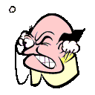
Stages of Team Development (Cont’d…)
Storming Stage: Conflicts, disagreements, resistance
Personal issues become apparent
(3 psychologies – Critical Parent, Child, Adult)
Concern for other members views, values
Ineffective confrontation
Dissatisfaction
Some Concerns:
Team too disjoined to reach the next stage
Just acting out the roles, no real involvement
IT3090 - Business Management for IT- Lecture 02 - Ms. Nilmini Rathnayake

Slide 24

Stages of Team Development (Cont’d…)
Norming Stage: Settling down having reached common
understanding, cooperation, collaboration
Confidence and trust grows
Systematic and open approach develops
Consider other options and valuing of others skills
Clarification of purpose and objectives
Prepare plans and measure progress
IT3090 - Business Management for IT- Lecture 02 - Ms. Nilmini Rathnayake

Slide 25
Stages of Team Development (Cont’d…)
Performing Stage: Reaching team goals
Focused
Everyone is involved
Flexibility ( no resistance )
Leadership is given relevant to task
IT3090 - Business Management for IT- Lecture 02 - Ms. Nilmini Rathnayake

Slide 26
Controlling
Management Functions
What is the basic economic problem ?
IT3090 - Business Management for IT- Lecture 02 - Ms. Nilmini Rathnayake

Slide 27
Controlling
Controlling is monitoring the organizational progress toward its goals.
Managers need to ensure that the people functions/perform in a manner to achieve set goals.
e.g.
Have the sales person achieved the targets?
If not why? What are the reasons for the deviations ? What are the corrective actions required?
IT3090 - Business Management for IT- Lecture 02 - Ms. Nilmini Rathnayake

Slide 28



References
IT3090 - Business Management for IT- Lecture 02 - Ms. Nilmini Rathnayake

Slide 29

IT3090 - Business Management for IT- Lecture 02 - Ms. Nilmini Rathnayake

